Slide 1
DAC 0800 Interfacing with 8085

Slide 2
About DAC 0800
To convert the digital signal to analog signal a Digital-to-Analog Converter (DAC) has to be employed.
The DAC will accept a digital (binary) input and convert to analog voltage or current.
Every DAC will have "n" input lines and an analog output.
The DAC require a reference analog voltage (Vref) or current (Iref) source.
The smallest possible analog value that can be represented by the n-bit binary code is called resolution.
The resolution of DAC with n-bit binary input is 1/2nof reference analog value.
Every analog output will be a multiple of the resolution.
For example, consider an 8-bit DAC with reference analog voltage of 5 volts. The analog values for all possible digital input are as shown.

Slide 3
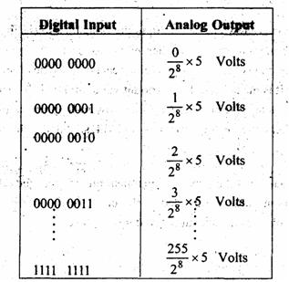

Slide 4
PIN DIGRAM & BLOCK DIAGRAM OF DAC0800
The DAC0800 is an 8-bit, high speed, current output DAC with a typical settling time (conversion time) of 100 ns.
It produces complementary current output, which can be converted to voltage by using simple resistor load.
The DAC0800 require a positive and a negative supply voltage in the range of ± 5V to ±18V.
It can be directly interfaced with TTL, CMOS, PMOS and other logic families.
The reference voltage and the digital input will decide the analog output current, which can be converted to a voltage by simply connecting a resistor to output terminal or by using an op-amp I to V converter.

Slide 5
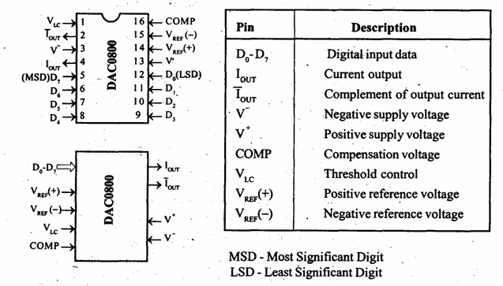

Slide 6
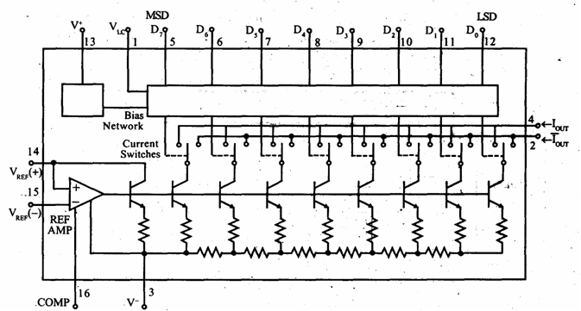
The internal block diagram of DACO800

Slide 7
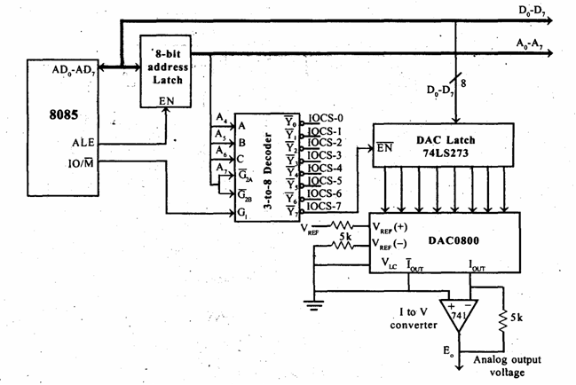
INTERFACING OF DAC0-800 WITH 8085

Slide 8
The DAC0800 can be interfaced to 8085 system bus by using an 8-bit latch and the latch can be enabled by using one of the chip select signal generated for I/O devices. A simple schematic for interfacing DAC0800 with 8085 is,
In this schematic the DAC0800 is interfaced using an 8-bit latch 74LS273 to the system bus.
The 3-to-8 decoder 74LS 138 is used to generate chip select signals for I/O devices.
The address lines A4, A5 and A6 are used as input to decoder.
The address line A7 and the control signal IO/M (low) are used as enable for decoder.
The decoder will generate eight chip select signals and in this the signal IOCS-7 is used as enable for latch of DAC.

Slide 9
In order to convert a digital data to analog value, the processor has to load the data to latch.
The latch will hold the previous data until next data is loaded.
The DAC will take definite time to convert the data. The software should take care of loading successive data only after the conversion time.
The DAC 0800 produces a current output, which is converted to voltage output using Ito V converter.

